Slide 1
SMART RETAIL

Slide 2

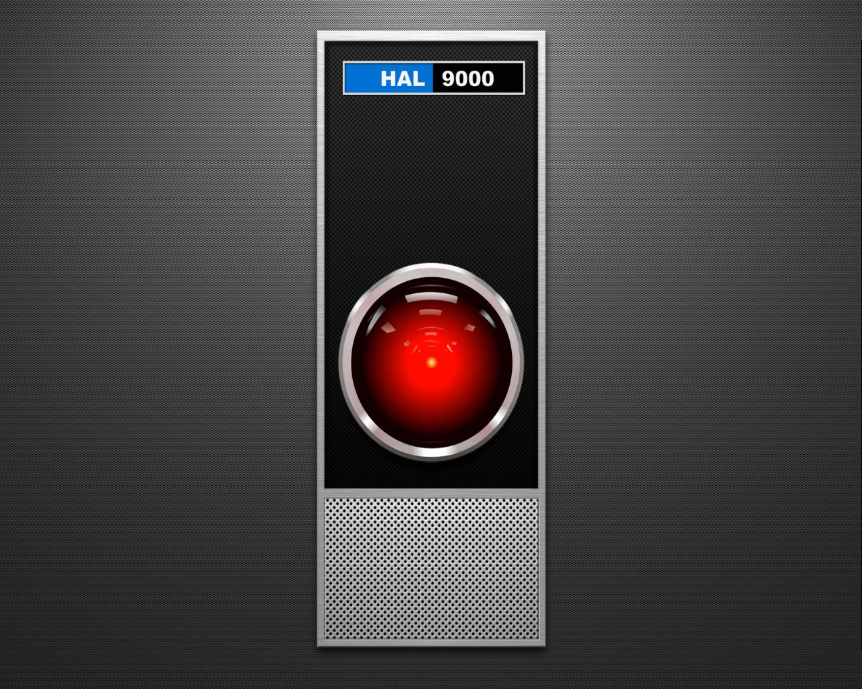
HELLO!
We are H.A.L
A shopping assistant that integrates social media

Slide 3
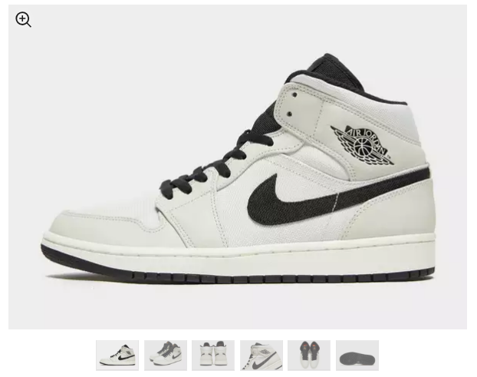
The Problem
The product pictures are often limited to studio pictures, not showcasing a real-life experience.

Slide 4
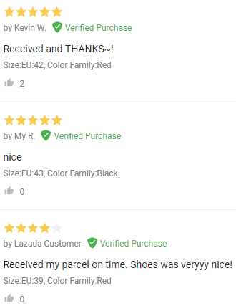
The Problem
How often have you tried reading the reviews and NOT gain any useful information or insight on the product?

Slide 5
Solution
With H.A.L we show you what other people have to say about the products, and a variety of pictures related to it.

Slide 6
DEMO

Slide 7
The Benefits
Place your screenshot here
SALES
More closing sales, better information regarding the product
Connection
Connects the product to the customer through social media accounts

Slide 8

THANKS!
Any questions?

